Slide 1
UNCERTAINTY QUANTIFICATION OF AGENT-BASED MODELS WITH APPLICATION TO MALARIA INTERVENTION MODELING
PhD Student: Zenabu Suboi
First Supervisors: Dr. Emilie Pothin
Prof. Dr. Christian Lengeler
Dr. Christian Selinger
Second Supervisor: PD Dr. Amanda Ross

Slide 2
Background training
Education
Current Work Experience
Dec 2023 - Ongoing 01.2019 – 12.2020 08.2017 – 06.2018 | PhD Candidate, Epidemiology Swiss Tropical & Public Health Institute/ University of Basel, Switzerland Master in Mathematics, Stellenbosch University, South Africa Master in Mathematical Science, AIMS – South Africa
09.2012 – 06.2016 | Bachelor in Statistics, University for Development Studies, Ghana
10.2021 – Date | Assistant Lecturer at Academic City University College, Ghana

Slide 3
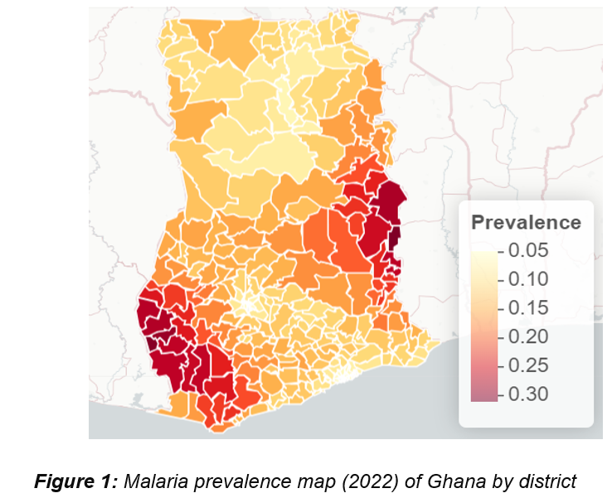
Malaria Prevalence in Ghana is highly heterogeneous
Data from …

Slide 4
Uncertainty in Agent-Based Model outputs stem from different sources
Model uncertainty
Stochastic uncertainty
Parameter uncertainty
Observation uncertainty
Model output
Notes:
In the context of ABMs, there are several acknowledged sources from which uncertainty can originate and then propagate through the model.
there are often uncertainties in the real-world process that an ABM is designed to simulate. This can be because any observations taken are inaccurate or because the system is stochastic and, therefore, multiple observations lead to dierent results

Slide 5
EIR is not the only source of Parameter Uncertainty in Intervention Modeling
EIR
ITN Effective coverage
Geostatistical Effective Intervention Coverage
SMC Effective coverage
Parameter uncertainty
Notes:
To address uncertainties, we identify and quantify the various sources of uncertainty explicitly

Slide 6
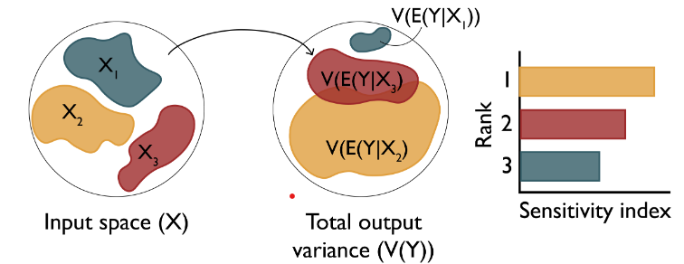
Research Objectives
Objective 1: Understand the key drivers of impact of interventions in Ghana
Objective 3: Simulate the impact of malaria interventions in Ghana in order to support decisions for strategic planning
Objective 2: Develop a novel inference framework for calibrating the OpenMalaria model at a higher spatial resolution

Slide 7
Research Objectives
Objective 1: Understand the key drivers of impact of interventions in Ghana
Objective 3: Simulate the impact of malaria interventions in Ghana in order to support decisions for strategic planning
Objective 2: Develop an efficient inference framework for calibrating the OpenMalaria model at a higher spatial resolution

Slide 8
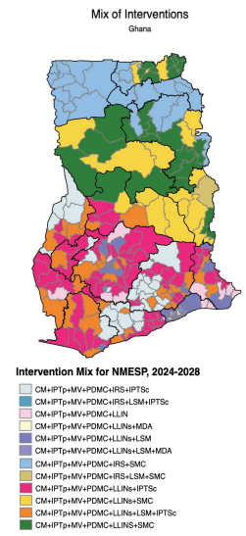
Research Objectives
Objective 1: Understand the key drivers of impact of interventions in Ghana
Objective 3: Simulate the impact of malaria interventions in Ghana in order to support decisions for strategic planning
Objective 2: Develop a novel inference framework for calibrating the OpenMalaria model at a higher spatial resolution

Slide 9
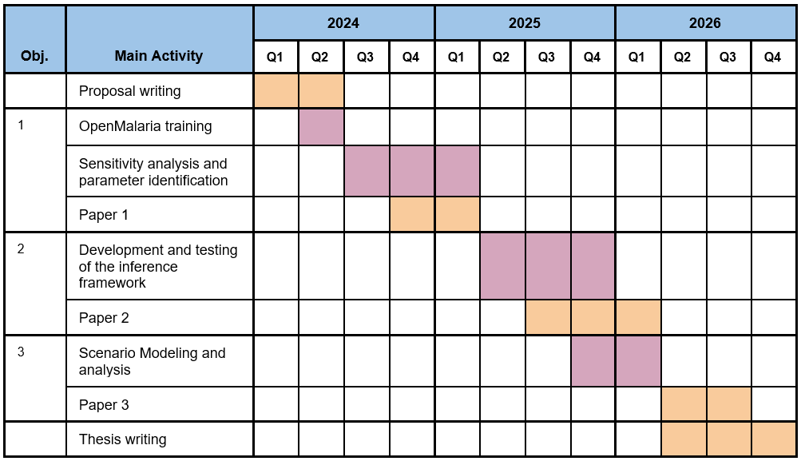
Timeplan and Milestones

Slide 10
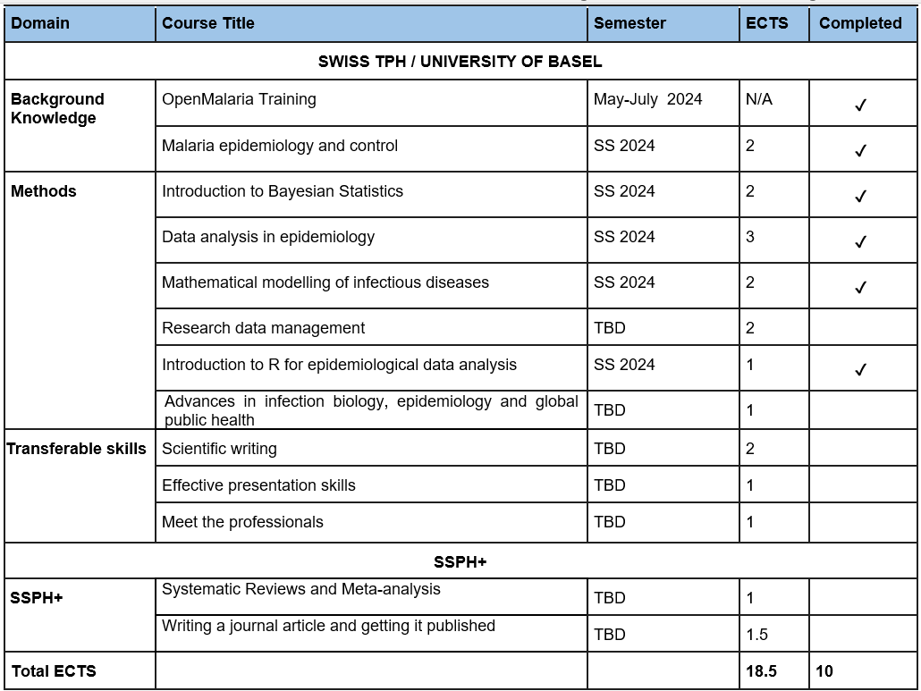
Learning Agreement

Slide 11
THANK YOU

